Slide 1
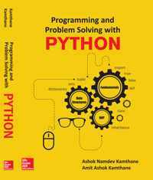
Programming and problem solving with python
Chapter 1
Introduction to Computer and Python Programming
Copyright © 2018 McGraw Hill Education, All Rights Reserved.
PROPRIETARY MATERIAL © 2018 The McGraw Hill Education, Inc. All rights reserved. No part of this PowerPoint slide may be displayed, reproduced or distributed in any form or by any means, without the prior written permission of the publisher, or used beyond the limited distribution to teachers and educators permitted by McGraw Hill for their individual course preparation. If you are a student using this PowerPoint slide, you are using it without permission.

Slide 2
History of Python
Written by Guido van Rossum
Started work in 1990
First release in 1991
Minor number releases every 6 months

Slide 3
Why Python?
Simple yet powerful syntax
Portability
Readability
Vast Support of libraries
Software Integration
Developer Productivity

Slide 4
WHY THE NAME "PYTHON"?
According to the principal author (Guido van Rossum), he chose the name "Python" because he is a big fan of the British comedy movie - 'Monty Python's Flying Circus'

Slide 5
Installing Python
Type http://www.python.org/ at the address bar of any browser and press enter.
Click on Downloads you will see the latest version of python. You can download by clicking on the latest version number.
*** But, try to download the Python version 3.4 since all the programs of book are written considering version no 3.4.

Slide 6
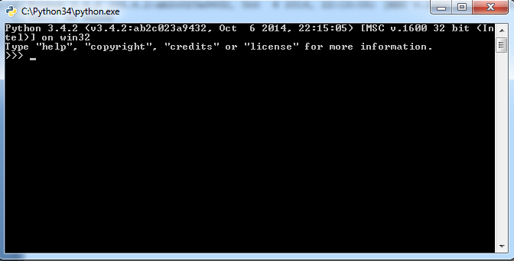
Starting Python in (Command Line ) Mode
Press Start button
Click all programs then click on Python 3.4.
Under Python 3.4 you can see list of python options. Click on Python
After clicking on it, you can see the python interactive prompt as follows

Slide 7
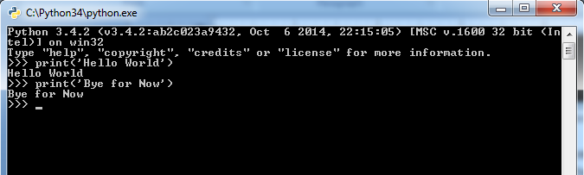
Continued….
A python command prompt contains an opening message >>>, called as “command prompt”.
The cursor at the command prompt waits for you to enter a python command.
The cursor at the command prompt waits for you to enter a python command.
For example let us write the first statement i.e. print(‘Hello World’) when executed in interactive mode of python command prompt it gives the output of the entered command i.e. for now it prints the message ‘Hello World’.

Slide 8
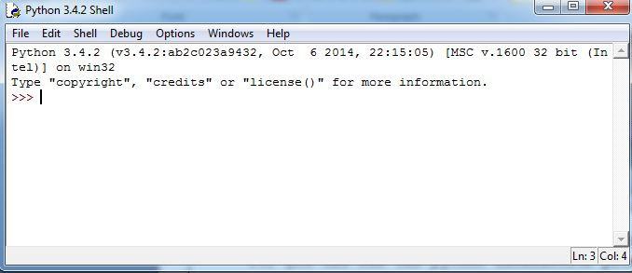
Launching Python Idle
The IDLE is graphical integrated development environment for python.
The python statements or commands which runs on interactive mode of python IDLE are called as shell.
Steps to launch it
- Press Start button
- Click all programs then click on Python 3.4. and then click on python IDLE. After clicking you can see python IDEL as follows

Slide 9
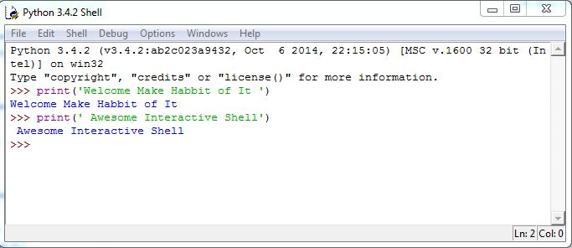
Continue…….
A Python interactive shell prompt contains an opening message >>>, called as “shell prompt”.
The cursor at the shell prompt waits for you to enter a python command.
A complete command is called as “statement”.
Following are the commands running on the shell prompt .

Slide 10
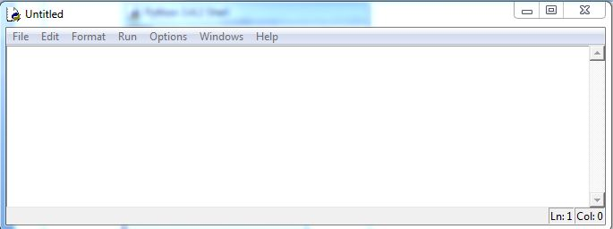
Executing Python Programs
Running python program from a script file is known as running python in “script mode”.
steps required to write python programs in python IDLE’S script mode.
In python IDLE’s - shell window, click on File and then click on New File or just click CTRL + N.
Enter Python Code Here

Slide 11
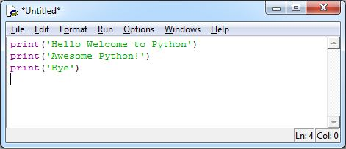
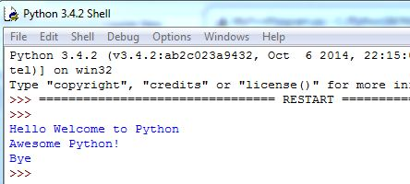
First Python Program in Script Mode
Let us consider the simple program to print the messages “Hello Welcome to Python”, “Awesome Python!” and “Bye” on the console.
Write the said statements on to the script mode
After writing save the file and click on Run on to the menu bar to see the output on the Interactive Mode as follows

Slide 12
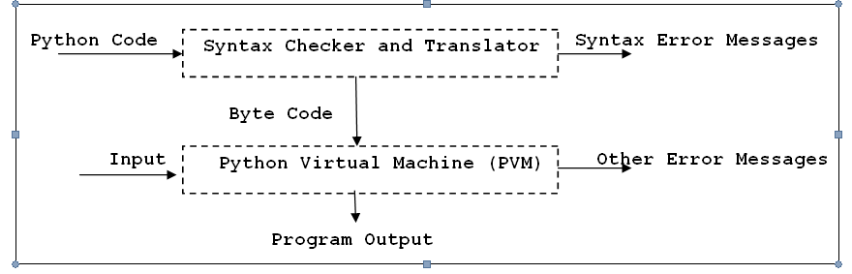
Working of Python Program

Slide 13
Conclusion
Python is general purpose, interpreted and objects oriented programming language
You can enter Python statements interactively from the Python prompt >>>
Python Programs can be written on the script mode and commands can be executed on the interactive mode.

